Slide 1
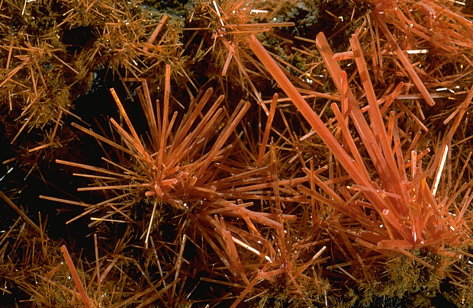
Transition
Metals

Slide 2
The transition metals (or d block elements) are :-
hard
dense
high strength
good conductors
have moderate reactivity
high melting and boiling points
show little variation in atomic radii – since the same s sublevel is the outer shell for each element within the period.

Slide 3
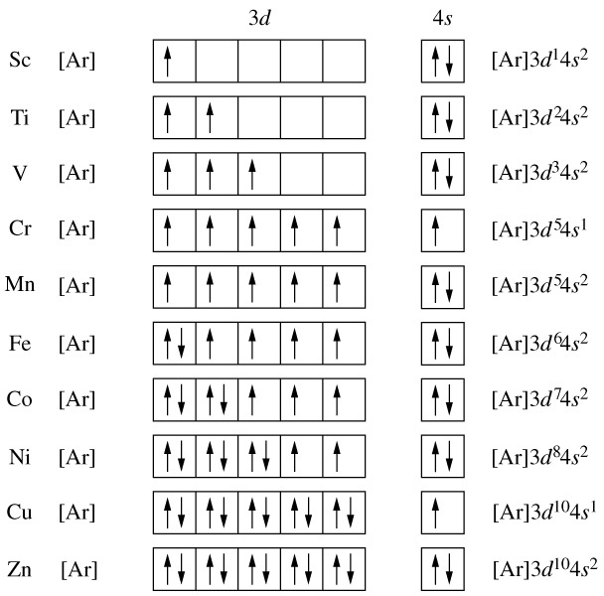
The Electron Configurations of the Transition Metals
The unexpected configurations of Cr & Cu tend to indicate that a more stable arrangement is achieved if the 3d orbitals are either all half –filled or all completely filled.

Slide 4
The Ionic States of the Transition Metals
In compounds they can exist in a variety of ionic states since electrons can be lost from the d or s orbitals – this is because the 4s and 3d energy sublevels have very similar energies.
Common Oxidation States of the First Series of Transition Metals
Sc
Ti
V
Cr
Mn
Fe
Co
Ni
Cu
Zn
+1
d¹⁰
+2
d³
d⁵
d⁶
d⁷
d⁸
d⁹
d¹⁰
+3
d⁰
d³
d⁵
d⁶
+4
d⁰
d³
+5
d⁰
+6
d⁰
+7
d⁰

Slide 5



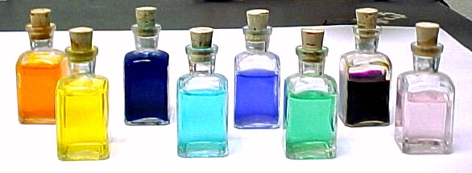
Transition Element
The Formation of Coloured Compounds
3d Sub-shell
4s Sub-shell
Sc
[Ar]
The absorption of light by transition metals compounds is due to the presence of unpaired d electrons in the ions. When light is absorbed, an electron is promoted from the lowest energy level (the ground state) to the a higher energy level (the excited state). These small energy differences are in the same range as the energies of photons of visible light.
Ti
[Ar]
V
[Ar]
Cr
[Ar]
Mn
[Ar]
Fe
[Ar]
Co
[Ar]
Ni
[Ar]
Cu
[Ar]
Zn
[Ar]

Slide 6
Transition Element
The Formation of Coloured Compounds
Can you suggest which ions are responsible for the colours of the solutions shown below?
Hint : Use the Chemistry Data Sheet.
3d Sub-shell
4s Sub-shell
Sc
[Ar]
Ti
[Ar]
V
[Ar]
Cr
[Ar]
Mn
[Ar]
Fe
[Ar]
Co
[Ar]
Ni
[Ar]
Cu
[Ar]
Zn
[Ar]

Slide 7
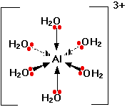
The Formation of Complex Ions
Formed between transition metals and ligands (anions or molecules) with lone pairs of electrons.
A coordinate covalent bond is formed between the central metal ion and each ligand by sharing a lone pair of electrons on the ligand.
Eg. Al [(H₂O)₆]³⁺

Slide 8
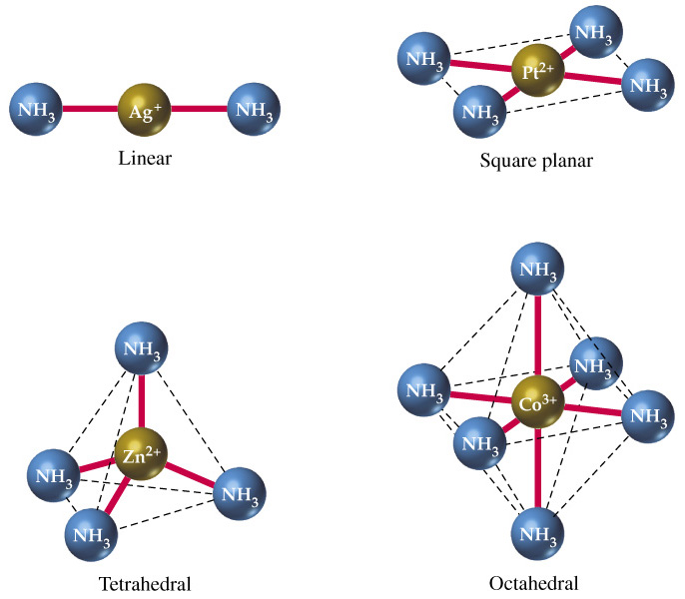
Four common structures of complex ions (with ammonia as the ligand).

Slide 9
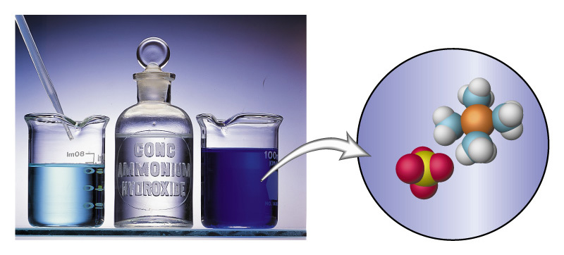
Reactions forming Complex Ions
Transition Element
3d Sub-shell
4s Sub-shell
Sc
[Ar]
Ti
[Ar]
V
[Ar]
Cr
[Ar]
Mn
[Ar]
Fe
[Ar]
Transition Metal ion + limited Ammonia Solution → Metal Hydroxide ppt
Eg. Cu²⁺_{(aq)} + 2 OH⁻_{(aq)} → Cu(OH)_{2(s)}
Addition of more ammonia solution results in the dissolving of the hydroxide and formation of a complex.
Trans. Metal ion + excess Ammonia Solution → Metal Ammonia complex
Eg. Cu(OH)_{2(s)} + 4 NH_{3(aq)} → [Cu(NH₃)₄]²⁺_{(aq)} + 2 OH⁻_{(aq)}
Co
[Ar]
Ni
[Ar]
Cu
[Ar]
Zn
[Ar]

Slide 10
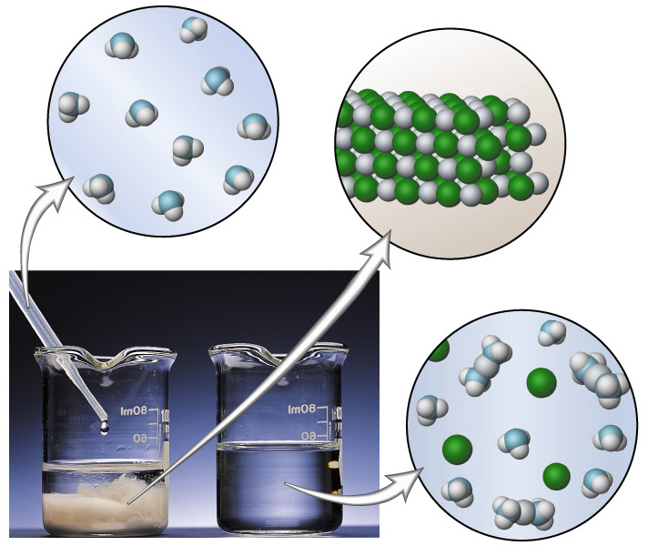
Reactions forming Complex Ions
Eg.2 A precipitate of AgCl_{(s)} (left) readily dissolves in an aqueous solution of NH₃ because of the formation of the complex ion [Ag(NH₃)₂]⁺ (right).
AgCl_{(s)} + 4 NH_{3 (s)} → [Ag(NH₃)₂]⁺ _{(s)}

Slide 11
Please Note :-
The formulae & colour of a number of transition metal ions & complex ions can be found on the Chemistry Data Sheet.

